Slide 1
Supervised Learning Logistic Regression and SVMs
Rayid Ghani
Slides liberally borrowed and customized from lots of excellent online sources

Slide 2
Types of Learning
Unsupervised
“Weakly” supervised
Fully supervised
Clustering
PCA
…
Anomaly Detection
Classification
Binary, multi-class, hierarchical, sequential
Regression

Slide 3
Supervised learning framework
y = f(x)
Training: given a training set of labeled examples {(x₁,y₁), …, (x_{N},y_{N})}, estimate the prediction function f that minimizes future generalization error
Testing: apply f to a new test example x and output the predicted value y = f(x)
features/variables/inputs/predictors/independent variables
Output / dependent
variable
Learned
function

Slide 4
Methods
Nearest neighbor
Decision Trees
Logistic Regression
Support Vector Machines
Bayes Classifier
Ensembles
Bagging
Boosting
Random Forests
Neural Networks
We’ll cover these two in class today

Slide 5
What we covered last class
Nearest Neighbor
Decision Trees

Slide 6
Logistic Regression
Maps x to a 0-1 space

Slide 7
Logistic Regression
Goal: estimate parameters (β_{i}) to estimate log-odds Log (P/ (1– P))
Log (P/ (1– P)) = β₀ + β_{i} X_{i}

Slide 8
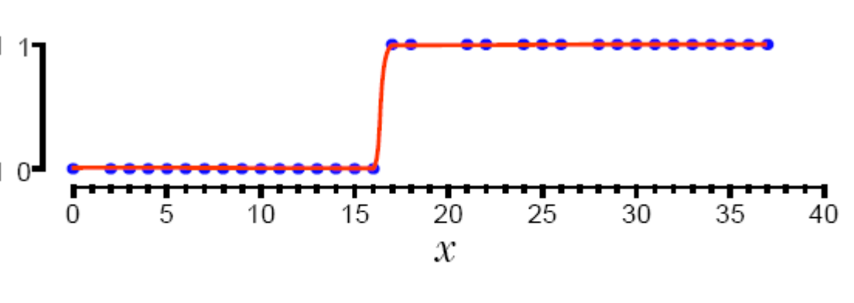
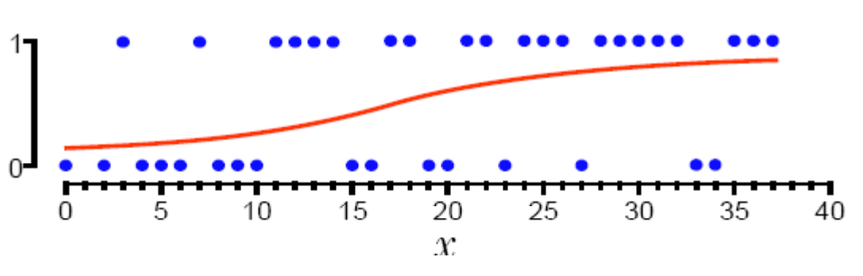
1-Dimensional Decision Boundary

Slide 9
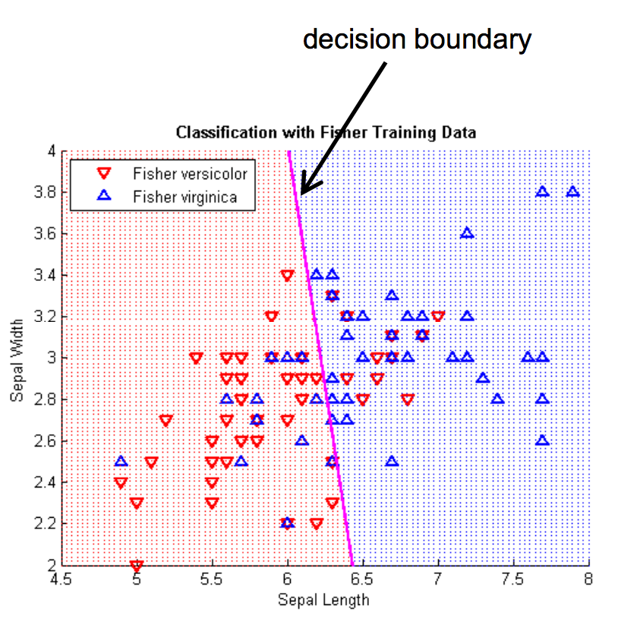
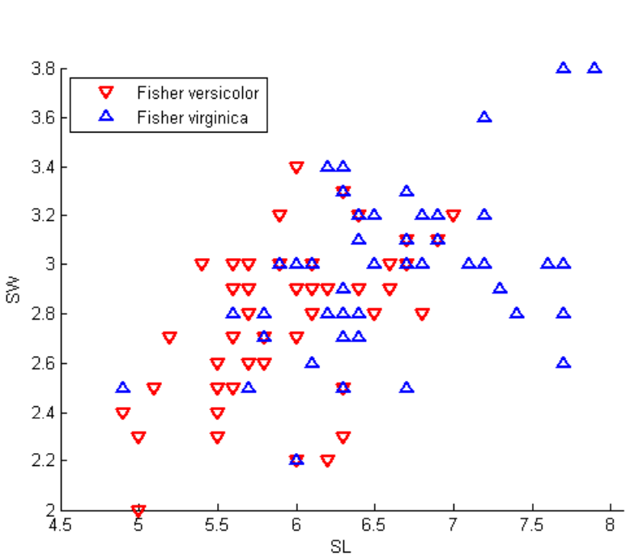
2-D Decision Boundary

Slide 10
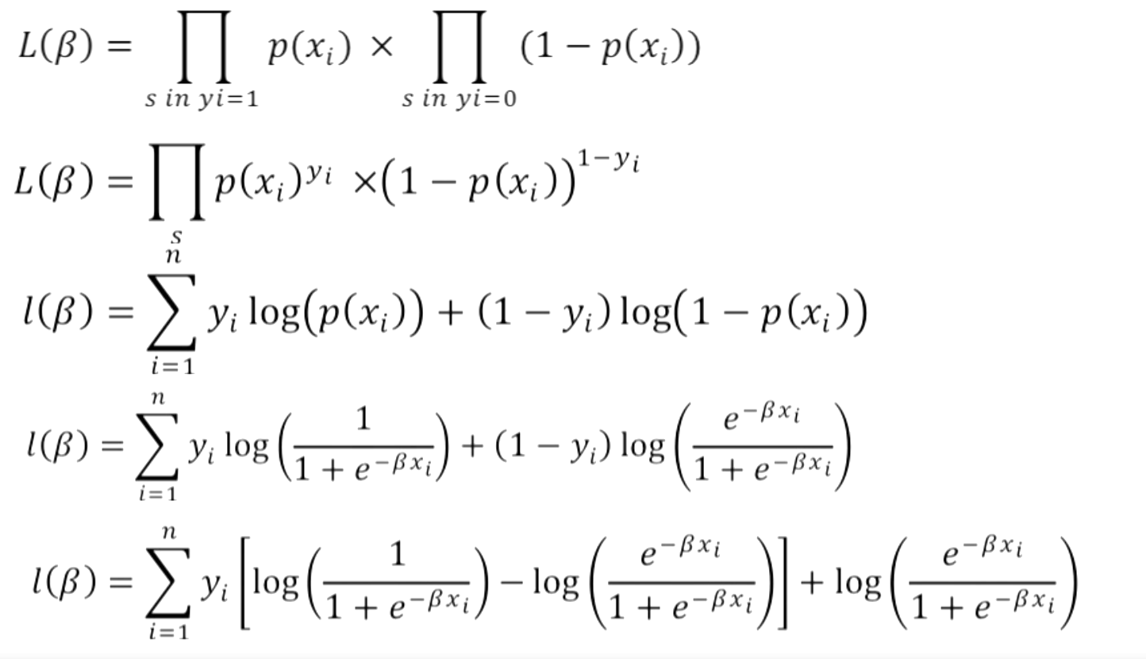
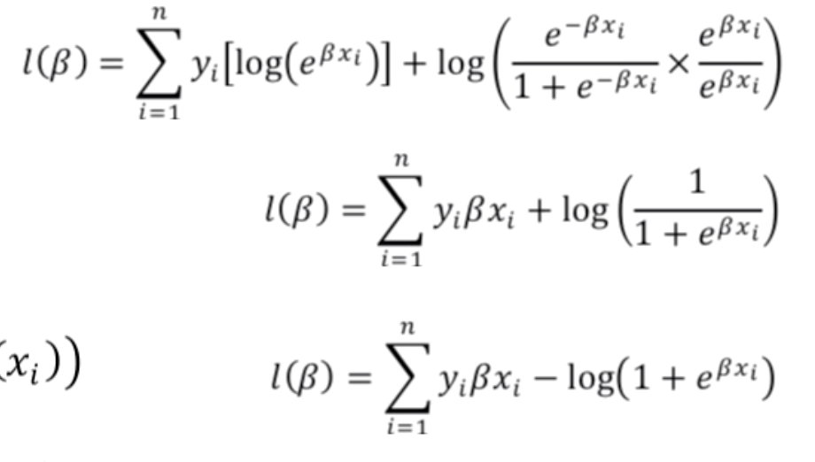
What are we optimizing for?
Goal is to Predict 1 for class 1, 0 for class 0
Find β_{i} to maximize

Slide 11
Training
Cost Function

Slide 12
How do you train a Logistic Regression model?
(Stochastic) Gradient Descent
For each training data point
Predict using current coefficients
Estimate new coefficients using errors

Slide 13
Interpreting Logistic Regression coefficients
effect of the independent variable on the "odds ratio"
Expected change in log odds ln(p/(1-p) because of a one-unit increase
What does that mean in terms of change of probability?

Slide 14
How does Logistic Regression control underfitting and overfitting?

Slide 15
Regularization
A way to reduce overfitting in machine learning models by adding penalties for increasing model complexity
Logistic Regression:
Early stopping
add a penalty term to the cost function based on non-zero coefficients
L1 (Lasso):
L2 (Ridge):

Slide 17
Regularization
What is the impact of L1 (Least Absolute Shrinkage and Selection Operator) ?
What does L2 do?

Slide 18
Data Preparation?
Do we have to do any data prep for logistic regression?

Slide 19
More about Logistic Regression
http://nbviewer.jupyter.org/github/justmarkham/DAT8/blob/master/notebooks/12_logistic_regression.ipynb
Little deeper into Logistic Regression https://www.youtube.com/watch?v=31Q5FGRnxt4&list=PL5-da3qGB5IC4vaDba5ClatUmFppXLAhE
Visualization: https://florianhartl.com/logistic-regression-geometric-intuition.html

Slide 20
Linear Classifiers

Slide 21
Which is the “best” separator?

Slide 22
Support Vector Machines
The goal of a support vector machine is to find the optimal separating hyperplane which maximizes the margin of the training data.
ρ
r

Slide 23
w^{T}x + b = 0
w^{T}x + b > 0
w^{T}x + b < 0
y = f(x) = sign(w^{T}x + b)

Slide 24
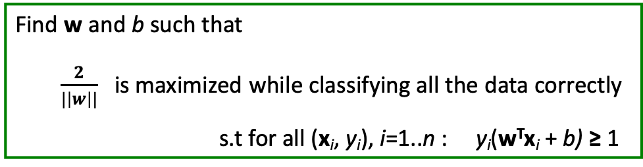
Linear SVMs Mathematically
Then we can formulate the quadratic optimization problem:
Which can be reformulated as:
Find w and b such that
$\frac{2}{|\left|w\right||}$ is maximized while classifying all the data correctly
s.t for all (x_{i}, y_{i}), i=1..n : y_{i}(w^{T}x_{i} + b) ≥ 1
Find w and b such that
||w|| ² is minimized
s.t for all (x_{i}, y_{i}), i=1..n : y_{i}(w^{T}x_{i} + b) ≥ 1

Slide 25
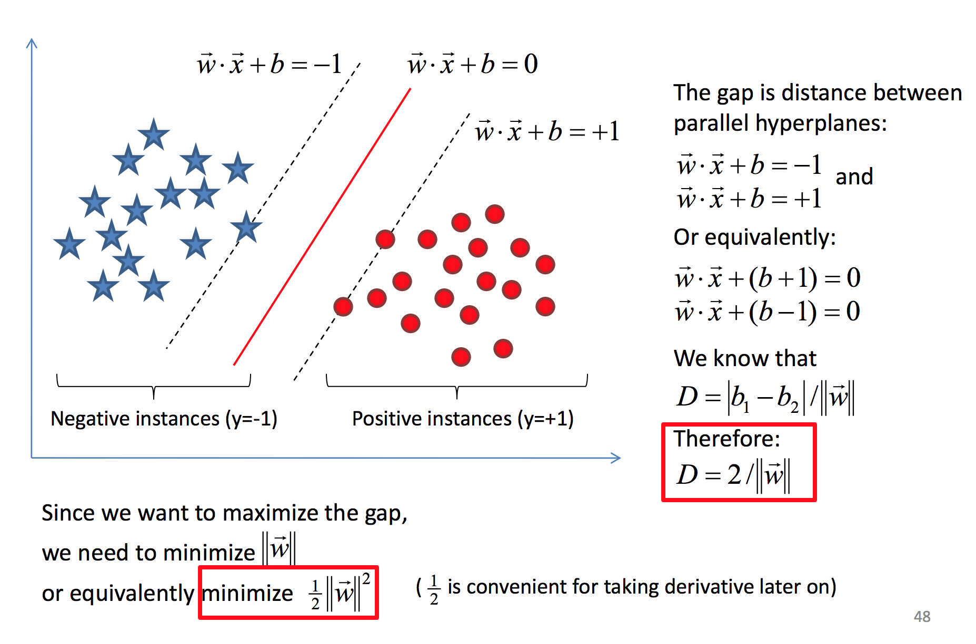

Slide 26
Solving constrained optimization
Use Lagrange Multipliers
Detailed Math: http://www.engr.mun.ca/~baxter/Publications/LagrangeForSVMs.pdf

Slide 27
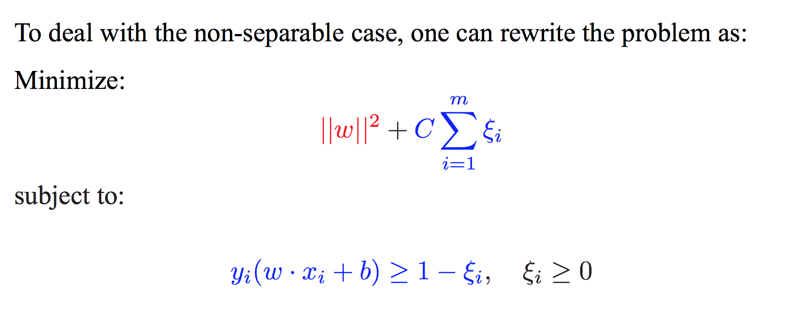
Slack Variables
If C is large, errors cost a lot (hard margin). If C is small, errors are tolerated (softer margin).

Slide 29
Nonlinear SVMs
Datasets that are linearly separable work out great:
But what if the dataset is just too hard?
We can map it to a higher-dimensional space:
0
x
0
x
x²
0
x

Slide 30
Logit vs Linear SVMs
Logistic regression maximizes the conditional likelihood of the training data
Linear SVM maximizes the margin

Slide 31
Using SVMs
Kernel: Linear, Polynomial, RBF
Normalizing features
Other Parameters
C: penalty for errors
No Probability estimates

Slide 32
Probabilistic Classifiers
We want to estimate P(class | data) for every class (and often pick the class with the max p( class | data)

Slide 33
Bayes’ Rule
For a data point d and a class c

Slide 34
Naïve Bayes Classifier
MAP is “maximum a posteriori” = most likely class
Bayes Rule
Dropping the denominator

Slide 35
Naïve Bayes Classifier
Data point d represented as features x1..xn

Slide 36
Naïve Bayes Classifier
O(|X|^{n}•|C|) parameters
How often does this class occur?
Could only be estimated if a very, very large number of training examples was available.
We can just count the relative frequencies in a data set

Slide 37
Naïve Bayes - Independence Assumptions
Conditional Independence: Assume the feature probabilities P(x_{i}|c_{j}) are independent given the class c.

Slide 38
Naïve Bayes Classifier

Slide 39
Naïve Bayes Example

Slide 40
Pros and Cons
Pros
Fast
No need to fill in missing data
Explicitly handles class priors
Incrementally updated
Cons
Independence assumption may be violated in practice (Features are correlated)
Gives skewed probability estimates when # of features is large. Why?

Slide 41
Questions to think about
When would Naïve Bayes fail?
How would you relax some of the assumptions behind naïve bayes to make it more robust?

